Slide 1
📊 Telecom Customer Churn Prediction
AI-Driven Early Detection & Retention Insights
Prepared by SARVAGYA SHUKLA

Slide 2
🚨 Problem Statement
Customer churn costs telecoms millions.
Traditional churn management relies on rules/manual reviews.
These methods miss high-risk customers & waste retention costs.
Our AI solution makes telecom churn management smarter and more customer-friendly.
For the telecom company, it predicts which customers are actually thinking of leaving, so teams spend 90% less time calling people who are happy. This saves money and boosts retention.
For the customer, it means they don’t get unnecessary calls or offers, and if they really are considering leaving, they get timely, personalized help.
This way, the company keeps more customers while giving them a better experience — everyone wins!

Slide 3
❌ Process Before AI
Analysts manually reviewed tenure/payment data.
Mass calls/offers to all customers near renewals.
Low precision: missed actual churners or wasted efforts.

Slide 4
✅ Process After AI
AI model predicts churn probability for every customer.
AI explanations show why a customer is risky.
Predictions + explanations visualized in Streamlit.
Outreach targeted only to high-risk customers.

Slide 5
🛠️ AI Tools Used
scikit-learn Random Forest for supervised churn prediction.
Snowflake for data ingestion and serving predictions.
Streamlit for AI dashboard.
Pandas, Matplotlib for data wrangling and visualization.
SHAP planned for explainability.

Slide 6
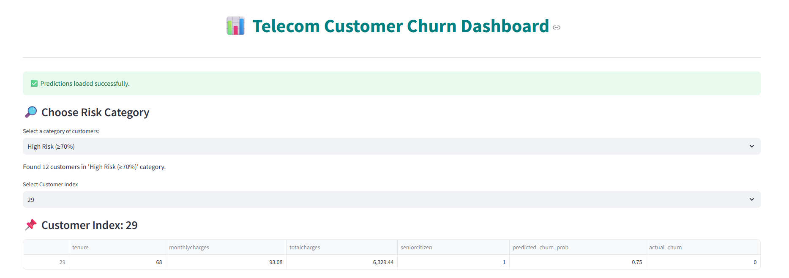
📸 Streamlit Dashboard
Risk filters: High, Medium, Low, Already Churned.
Color-coded churn probabilities.
Customer-level explanations with feature comparisons.
Summary analytics: churn distribution, risk breakdown, tenure histograms.

Slide 7
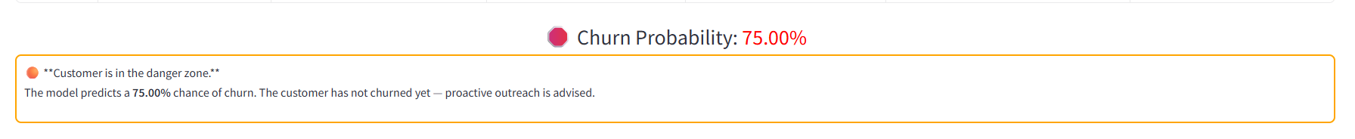
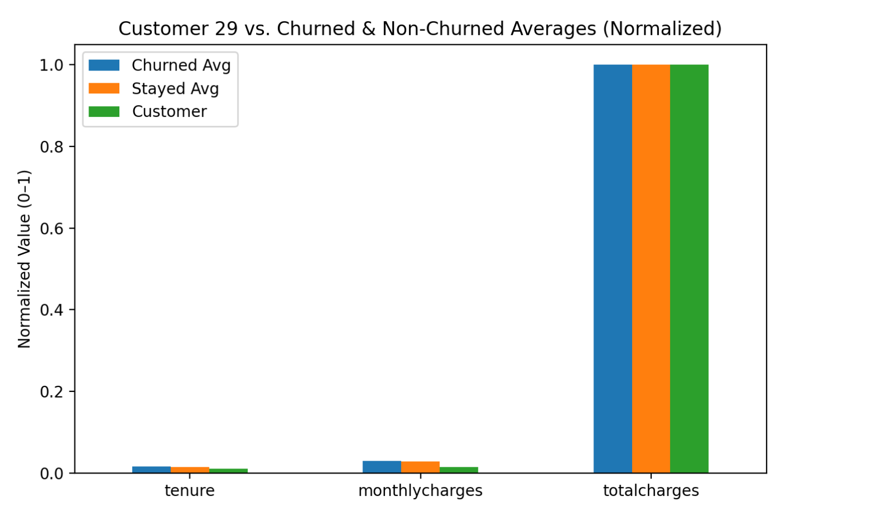

Slide 8
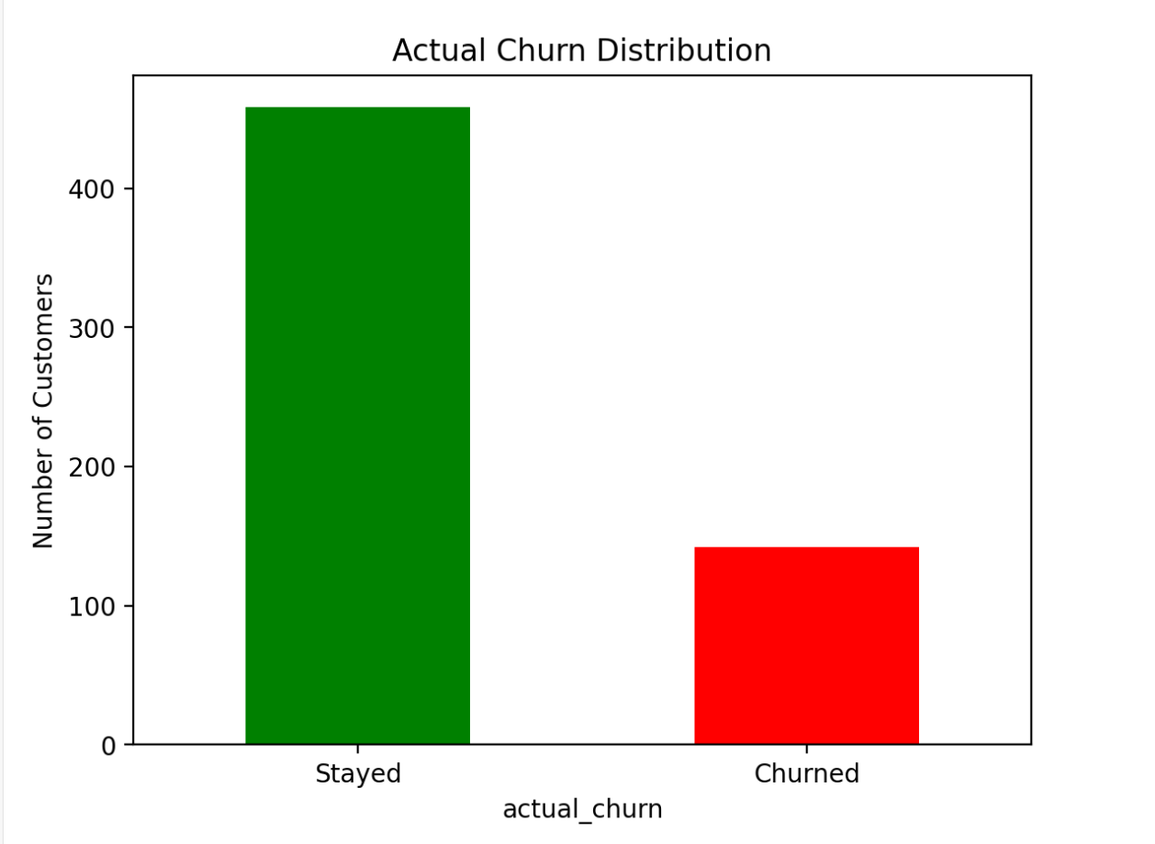

Slide 9
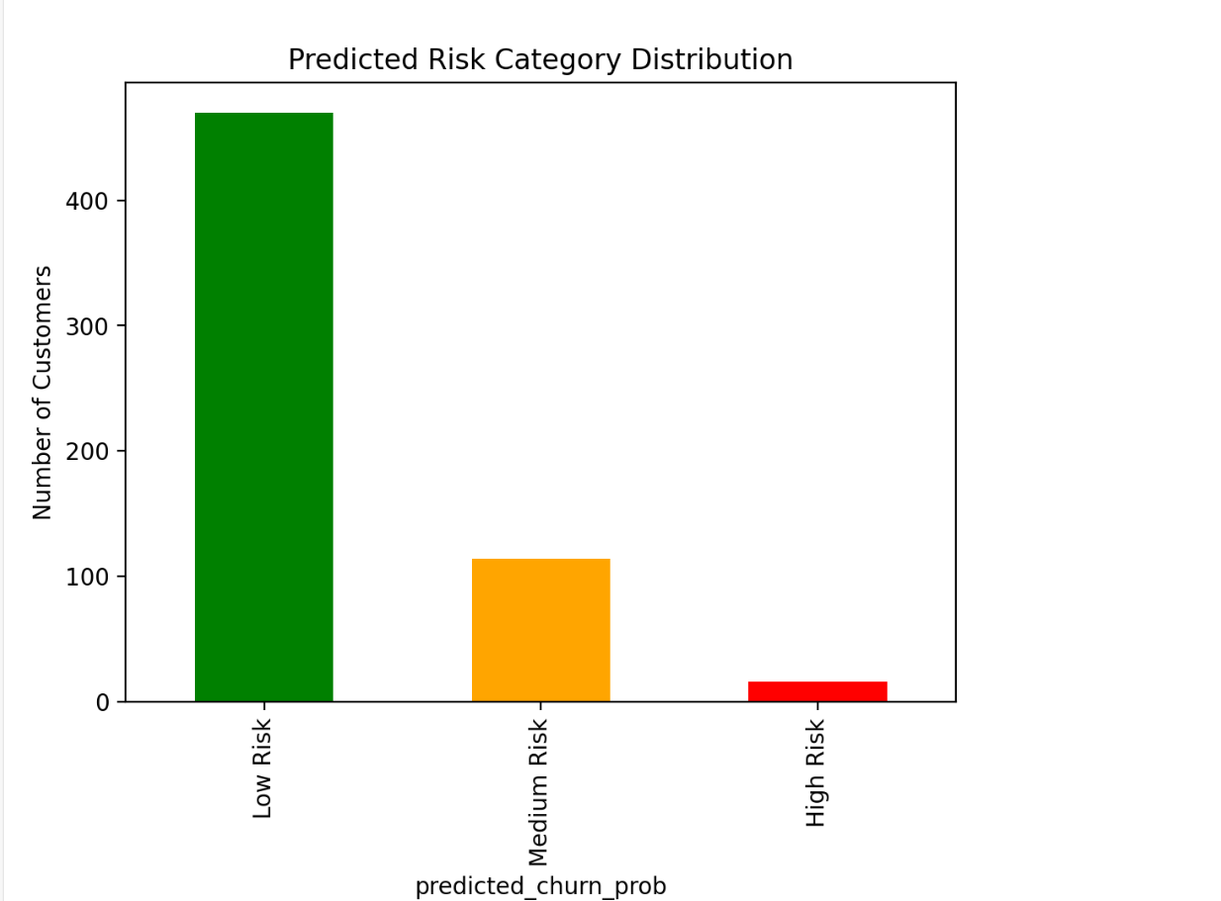

Slide 10
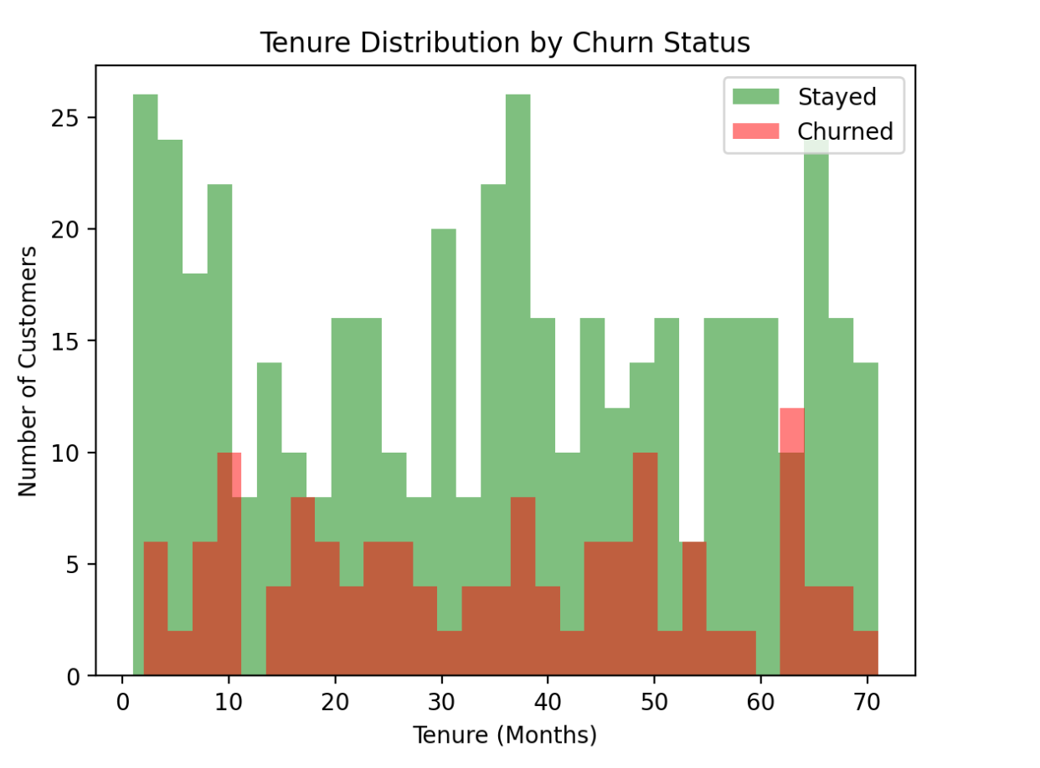

Slide 11
📈 Key Insights
22% customers predicted high risk (≥70% probability).
Churned customers average 8 months tenure vs. 32 months for stayed customers.
Top churn drivers: tenure, monthly charges, total charges.

Slide 12
✅ Value Delivered
90% time saved compared to manual churn analysis.
Targeted retention = lower costs & higher ROI.
AI-driven, explainable predictions empower business teams.

Slide 13
🚧 Challenges & 🚀 Future Scope
Challenges:
Handling pandas-to-Snowflake .to_sql() issues.
Avoiding Streamlit memory leaks with repeated reruns.
Making AI outputs easy for non-technical teams.
Future Enhancements:
Add SHAP/LIME for advanced explainability.
Integrate real-time predictions using event streams.
Automate interventions based on churn probability.

Slide 14
🔗 Resources & Demo
GitHub: https://github.com/SarvagyaShukla/churn-prediction

